Slide 1
MVC Validation & Edits
Annotation Source Code (copy this to a browser … it doesn’t like passing “#”):
http://referencesource.microsoft.com/#System.ComponentModel.DataAnnotations
David Turton
Conestoga College
Institute of Technology and Advanced Learning
dturton@conestogac.on.ca
Doon 2A605 x3610

Slide 2
Objective
Use annotations in the data model to edit input from the user
Ensure controller code recognises input errors
And returns user input to the view for correction
Add code to the view to display errors
To write a class library
Centralising corporate-common processes
Like edits, interest calculators, converters, etc.
Just how many times do you want to write a postal code edit?
Did you even know that only 18 letters are valid as the first character?

Slide 3
Data Annotations - like [Required]
Are attributes applied to the data model
Usually through a separate metadata class
Can centralise some custom annotations & processes in a class library
Razor annotates the HTML5 it creates
To include data-dash attributes to invoke Javascript-based edits
Annotations provided by Microsoft
Include JavaScript to validate input on the browser
Will inhibit submit if invalid
If JavaScript is turned off:
Most edits will still be performed, on the server
Custom annotations you write
Will not run on the browser
Unless you also write JavaScript for them

Slide 4
Metadata & Partial Classes
Don't mark up the generated models
If you regenerate them, you will lose the edits
Instead, add annotations to a metadata class
Apply this to a partial class named the same as the model
… & logically in same namespace
See prior lecture

Slide 5
Consider the Order Class
namespace MvcMusicStoreCore.Models
{
public partial class Order
{
public Order()
{
OrderDetail = new HashSet<OrderDetail>();
}
public int OrderId { get; set; }
public DateTime OrderDate { get; set; }
public string UserName { get; set; }
public string FirstName { get; set; }
public string LastName { get; set; }
public string Address { get; set; }
public string City { get; set; }
public string ProvinceCode { get; set; }
public string PostalCode { get; set; }
public string CountryCode { get; set; }
public string Phone { get; set; }
public string Email { get; set; }
public float Total { get; set; }
public virtual ICollection<OrderDetail> OrderDetail { get; set; }
public virtual Country CountryCodeNavigation { get; set; }
public virtual Province ProvinceCodeNavigation { get; set; }
}
}
Notice the namespace it's in … a logical construct
Notice it's a partial class

Slide 6
Order Class - Requirements
Some properties are from the user:
firstName, lastName, etc.
Some come from the environment & database:
orderDate & userName (user must log on to check out)
Some are derived or calculated:
total

Slide 7
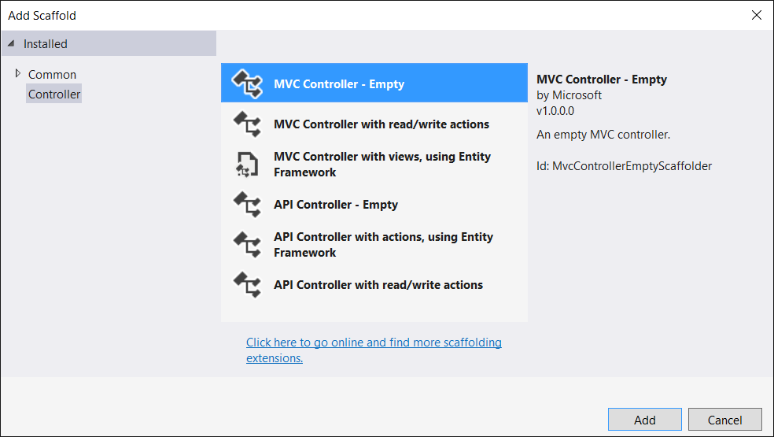
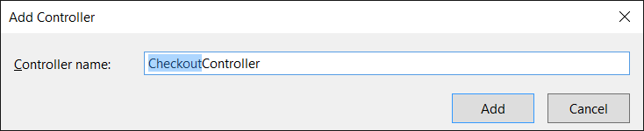
Create a Checkout Controller Empty … we'll code the actions

Slide 8
Add an AddressAndPayment action & a Create view for it
public class CheckoutController : Controller
{
private readonly MvcMusicStoreContext _context;
public CheckoutController(MvcMusicStoreContext context)
{
_context = context;
}
// set up page to create a new Order & collect user information
public IActionResult AddressAndPayment()
{
// create new Order object to force default values
Order order = new Models.Order();
order.OrderDate = DateTime.Now;
// create collections to populate the drop-downs
ViewBag.CountryCode = new SelectList(_context.Country.OrderBy(a => a.Name), "CountryCode", "Name");
ViewBag.ProvinceCode = new SelectList(_context.Province.OrderBy(a => a.Name), "ProvinceCode", "Name");
return View(order);
}
}

Slide 9
Some things to notice (& change) on the view
<form asp-action="AddressAndPayment">
<div class="form-horizontal">
<h4>Order</h4>
<hr />
<div asp-validation-summary="All" class="text-danger"></div>
<div class="form-group">
<label asp-for="Address" class="col-md-2 control-label"></label>
<div class="col-md-10">
<input asp-for="Address" class="form-control" />
<span asp-validation-for="Address" class="text-danger" />
</div>
</div>
.........
<div class="form-group">
<label asp-for="CountryCode" class="col-md-2 control-label"></label>
<div class="col-md-10">
<select asp-for="CountryCode" class ="form-control" asp-items="ViewBag.CountryCode"></select>
<span asp-validation-for="CountryCode" class="text-danger" />
</div>
</div>
.........
<div class="form-group">
<div class="col-md-offset-2 col-md-10">
<input type="submit" value="Create" class="btn btn-default" />
</div>
</div>
</div>
</form>
<div>
<a asp-action="Index">Back to List</a>
</div>
@section Scripts {
@{await Html.RenderPartialAsync("_ValidationScriptsPartial");}
}
<form> will POST to the current controller
Validation summary … use "All" instead of "ModelOnly" … spelling errors hide problems
Most inputs are datatype-dependent inputs
1-to-many relations become select lists without a field validation display … you should add it back
Submit button will be inhibited if there are any client-side validation errors
Add the validation support scripts to the proper section on the layout

Slide 10
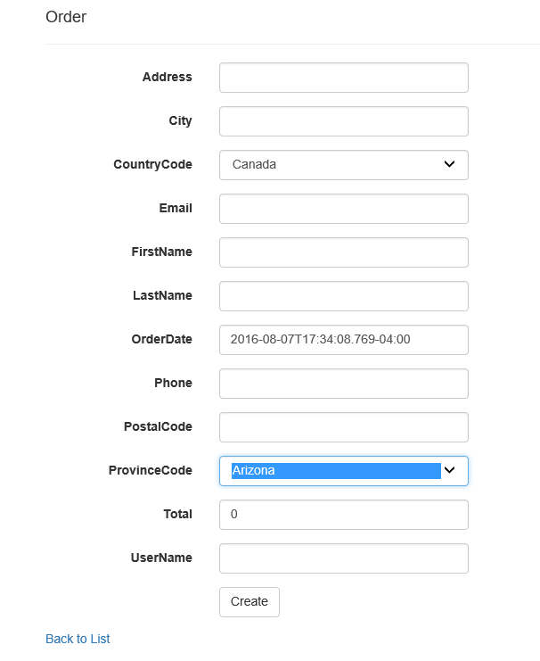
First Cut …
Date format is ugly
Provinces don't match country
Need a "where" clause
Inputs are listed alphabetically
Not grouped logically
Person, address, account, order …

Slide 11
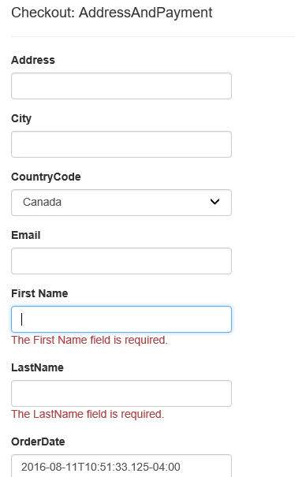
Validation Annotations namespace System.ComponentModel.DataAnnotations
Place attributes before the property they apply to
[Required]
Raises an error if property is null, empty or just spaces
public int OrderId { get; set; }
public DateTime OrderDate { get; set; }
public string UserName { get; set; }
[Display(Name ="First Name")]
[Required]
public string FirstName { get; set; }
[Required]
public string LastName { get; set; }

Slide 12
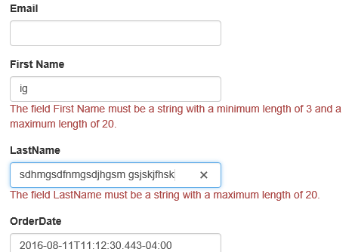
String Length
[StringLength(120)]
Maximum length 120 characters
[StringLength(120, MinimumLength=3)]
Must be at least 3 characters, max 120
[Display(Name ="First Name")]
[Required]
[StringLength(20, MinimumLength = 3)]
public string FirstName { get; set; }
[Required]
[StringLength(20)]
public string LastName { get; set; }

Slide 13
Regular Expression → this does not check for null/empty/spaces
Ensures text, if provided, meets a certain pattern
Phone numbers, e-mails, postal/zip codes
[RegularExpression(@"^\d{3}-\d{3}-\d{4}$")]
String must match the whole pattern
"^" and "$" will be assumed, but can be included
I like to add them for consistency … if these are missing in C# code, it'll allow trash to pass if the pattern is found somewhere in the string

Slide 14
Regular Expression Metadata annotations
[RegularExpression(@"^[A-Za-z]\d[A-Za-z] ?\d[A-Za-z]\d$")]
public string PostalCode { get; set; }
[RegularExpression(@"^[A-Za-z][A-Za-z]$")]
public string CountryCode { get; set; }
[RegularExpression(@"^\d{3}-\d{3}-\d{4}$")]
public string Phone { get; set; }
[DataType(DataType.EmailAddress)]
public string Email { get; set; }
!
By the way, that's not a good postal code edit … I think the first letter can only be one of 16 characters and the other two can only be one of 18 characters
How many times do you want to figure this out?

Slide 15
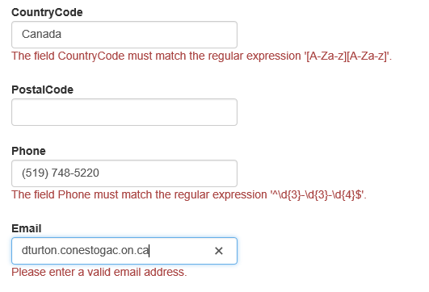
Regular Expression Results
Regular express messages are uuuugly … we'll fix them later
Annotations allow null because fields may be optional. If a value must be provided, add [Required]
You can write your own email regular expression or invoke HTML5's <input type="email" …/> by refining the field's datatype

Slide 16


Range - range values can be variables, but must be static (class) variables
Minimum and maximum numeric value
Range values are inclusive
[Range(0,100)]
Works for integers and doubles
[Range(typeof(Decimal), "0.00", "100.00")]
Suggested structure for decimal & date ranges … doesn't work
[Range(typeof(DateTime), "23 Jun 2016","31 Dec 2016")]
public DateTime OrderDate { get; set; }
[Range(0.0, 100.0)]
public float Total { get; set; }
Numeric checks are fine
Date checks … no so good

Slide 17
A suggestion about [Range] - don't use it.
You rarely have static ranges
Marks between 0 and 100
Days in week, months in year …
Even if the date range worked
You probably want the ranges to be variables
…but attribute arguments must be constants
It's never correct to prove "x must be greater than 5"
[Range] imposes an upper limit not required by the criteria
I suggest you write your own validation code
As a custom attribute, [Remote], or in the model's Validate method

Slide 18
[Remote("action", "controller")] - real-time custom validation
Validation runs on the server as user is typing into target field
Calls the specified action on the server
Passing the field's name and value
Microsoft provides the jQuery to run this on browsers
Uses JavaScript Object Notation (JSON) in the background
Anything the server has access to can be used in the edit:
Validate a field value against the database
… or call a corporate-standard validation procedure
However: only fires if user types into the target field
Won't fire on unit tests (no user)

Slide 19

Remote example
Validation code in CheckoutController:
Annotation in order metadata:
// verify the order date is not in the future
public JsonResult OrderDateNotFuture(DateTime orderDate)
{
Boolean isTodayOrBefore = orderDate <= DateTime.Now;
return Json(isTodayOrBefore, JsonRequestBehavior.AllowGet);
}
If the condition is true, allow submission to server … anything else inhibits submission
[Remote("OrderDateNotFuture", "Remotes")]
public System.DateTime orderDate { get; set; }
We'll modify the error message later

Slide 20

[Remote] – alternate messages
If the 1st parameter to Json is true
This will allow the submit to proceed
Anything else
The submit is inhibited
If it's false
You get 'xxxx' is invalid
If it's a string
This becomes the error message
public JsonResult OrderDateNotInFuture(DateTime orderDate)
{
if (orderDate <= DateTime.Now)
return Json(true);
else
return Json("order date cannot be in the future");
}

Slide 21
[Remote("OrderDateNotFuture", "Remotes")]
[Remote] doesn't fire when user first types into the target field
It fires when user tabs off the field or clicks submit
If the field is invalid, the error message is shown to the user & submit is inhibited
Subsequently, [Remote] executes on each keystroke as the user types corrections
[Remote] will not fire
If the field is unchanged (user didn't type into it) or it is empty/emptied
There's a good side to this …
I used to worry about which controller to use …
Now, I create one controller caller "Remotes" for all [Remote] actions
It's just a suggestion … no magical implications
... "Fred" would work just as well … but will lose marks: meaningful names … remember?

Slide 22
Checking for Duplicate Primary Key - with [Remote]
When editing for a duplicate key
Page needs to know if user is creating or editing a record
Auto-number key is easy → user can't enter it → zero if creating
Manual keys are not as easy:
"QC" is already on the province table
Are you inserting a duplicate key
… or updating the tax rate on an existing record?
[Remote] only fires when the user modifies the target field
The primary key is protected on Edit views – user cannot touch it
…so if [Remote] calls its controller action, you're on the Create view
If key is on file, it's a duplicate-key error → no discussion required

Slide 23
Checking for Duplicate Non-Key fields … such as "Name" in province table …
Criteria is:
"the name must be unique: it cannot be on two or more records"
This actually easy:
Look for a record on file with the same name
If you find one:
Same name, same key is OK – user's editing an existing record
Same name, different key is an error … user is:
Creating a new record with the same name
Changing an existing record to the name on another record
If the key is manually-entered (like provinceCode):
You should check for a duplicate key first
The name logic could pass edits but throw a database exception

Slide 24
Compare
Compares current field with another field on form
Returns "valid" if they're both equal.
Great for checking password & email spelling:
Password & repeat-password inputs are the same
Useless for everything else
Here, it's a validator on repeatPassword
What if user modifies "password" afterwards?
Is validation re-run on browser or server?
[System.Web.Mvc.Compare(“password")]
public String repeatPassword{ get; set; }
Passing another field (password) to the "repeatPassword" validation

Slide 25
Custom Error Messages
This is not a clear message to users:
The field PostalCode must match the regular expression '^[A-Za-z]\d[A-Za-z]...
Every validator allows a custom error message:
[RegularExpression(@"^[A-Za-z]\d[A-Za-z] ?\d[A-Za-z]\d$",
ErrorMessage = "postal code is not a valid Canadian pattern: A3A 3A3")]
public string PostalCode { get; set; }
This will override the default message
→ and give guidance as to the correct pattern

Slide 26


Adding a field-name to error message
Can put a parameter in the custom message
{0} will be replaced by field's display-name
[RegularExpression(@"^[A-Za-z]\d[A-Za-z] ?\d[A-Za-z]\d$",
ErrorMessage="the {0} is not a valid Canadian pattern")]
public String PostalCode { get; set; }
Default display-name is the property name
[RegularExpression(@"^[A-Za-z]\d[A-Za-z] ?\d[A-Za-z]\d$",
ErrorMessage="the {0} is not a valid Canadian pattern")]
[Display(Name="Cdn Postal Code")]
public String PostalCode { get; set; }
Can override with a friendlier display-name

Slide 27
When does Validation Run?
Server-side validation runs during model binding
Model binding runs if the receiving action has a parameter:
[HttpPost]
[ValidateAntiForgeryToken]
public async Task<IActionResult> Create([Bind("…")] Album album)
{
if (ModelState.IsValid)
{
_context.Add(album);
await _context.SaveChangesAsync();
return RedirectToAction("Index");
}
ViewData["ArtistId"] = new SelectList(_context.Artist.OrderBy(a => a.Name), "ArtistId", "Name");
ViewData["GenreId"] = new SelectList(_context.Genre.OrderBy(a => a.Name), "GenreId", "Name");
return View(album);
}
Happy path
Sad path

Slide 28
TryUpdateModelAsync() To explicitly invoke model binding & validation
If there are edits on computed fields
You need to compute them before Binder does the edits
→ You need to control when Binder runs
TryUpdateModelAsync(objectOfModelClass)
Invokes Binder, returns True if edits passed
…false if Binder finds an error
[HttpPost]
public async Task<IActionResult> Edit(FormCollection inputStuff)
{
Order order = new Models.Order();
order.Total = SumOrderDetailRecords(Convert.ToInt32(inputStuff["OrderId"]));
if (await TryUpdateModelAsync(order))
{
...continue happy path...
FormCollection: all inputs on web page, indexed by fieldname

Slide 29
ModelState
Contains all values the user attempted to enter
Especially ones invalid for a property's DataType
Contains errors for each property
& errors associated with the model itself
ModelState.IsValid (a Boolean)
Returns false if there are any errors in ModelState
Returns true otherwise
To check for errors on a specific property:
if (ModelState["QuantityOrdered"].Errors.Count > 0)
…nice thing to check before doing calcs with it…

Slide 30
To Set & Display Validation Errors
To manually add field errors to ModelState:
ModelState.AddModelError("FirstName", "Is required.");
ModelState["FirstName"].Errors.Add("Is required.");
And errors not associated with a field:
ModelState.AddModelError("",
$"error inserting new order: {ex.GetBaseException().Message}");
To List all validation errors in ModelState on a View:
<div asp-validation-summary="All" class="text-danger"></div>
To list only Model-level errors (no field-name):
<div asp-validation-summary="ModelOnly" class="text-danger"></div>
To show the first validation error for a specific field:
<span asp-validation-for="LastName" class="text-danger" />
Loop through ModelState["LastName"].Errors[i] to get all errors

Slide 31
Post-Back Action if valid, add fields the user can't enter, then add to database otherwise, return user's actual input to them for correction
Model binder creates/loads model and performs validation here
[HttpPost]
public async Task<IActionResult> AddressAndPayment(Order order)
{
try
{
if (ModelState.IsValid)
{
order.UserName = User.Identity.Name; // from user account sign-on
order.OrderDate = DateTime.Now;
_context.Add(order); // queue-up new record
await _context.SaveChangesAsync(); // commit the record to the database (re-executes edits)
TempData["message"] = "order created"; // provide feedback to the user
return RedirectToAction("AddressAndPayment"); // return to setup action for next page
}
}
catch (Exception ex)
{
ModelState.AddModelError("", $"error inserting new order: {ex.GetBaseException().Message}");
}
AddressAndPayment(); // call setup action to initialise ViewBag for dropdowns
return View(order); // pass order as Model: includes user inputs & ModelState errors
}
Sad Path: We're returning the model to the view, along with the ModelState.
The view populates controls by name, looking in ModelState first … invalid data types entered by user will be in the ModelState, not the model. If it doesn't find a like-named field in ModelState, it'll look in the model.

Slide 32
System.ComponentModel.DataAnnotations
Contains other attributes of use:
As well as the class to create your own attributes
[EmailAddress]
Can translate the error message, but doesn't add pattern edit
[MaxLength] [MinLength]
vs [StringLength]
[FileExtension]
[Phone]
[TimeStamp]
… not what you'd think

Slide 33
No Validators on Dropdowns
Validation Annotations, [Remote]
Just don't fire on dropdowns
Later, we'll look at custom annotations
The Validate method in to model can edit data from drop-downs.

